Slide 1



Special SURVEY
Gender equality
UNDER UMBARGO

Slide 2








The 6 action coalitions
of the Equality Generation Forum
Gender-based violence
Economic justice & economic rights
Body Autonomy
and sexual and reproductive health and rights
Feminist action for climate justice
Technology and Innovation for Gender equality
Feminist movements and leadership
UNDER UMBARGO

Slide 3





Online survey carried out by the YouGov Institute between February 5 and 13, 2020
Sample of 2003 people representative of the French population
Retained margin of error: - / + 2%
Figures are expressed as a percentage. For some questions asked exclusively to men or women, the sample is around 1000 respondents.
UNDER UMBARGO

Slide 4
Considering equality between women and men as an axis of observation :
Women consistently demonstrate a higher sensitivity than men. Their points of view are not opposed but more emphasized.
A large majority of men are aware of the issue of equality : men are aware of inequalities, of the need for change and the majority of them are in favour of change.
The usual socio-demographic determinants are not as effective as what is generally observed on DEL in relation to development issues.
Differences in positioning are more centered on life stages and generational variations
Counterintuitively, older respondents are, for example, more aware of gender equality than middle-aged people.
The slightly greater sensitivity of left-wing supporters to equality represents nothing more than a trend.
Whatever the point of view, whether cultural or ideological, in France, gender equality is a struggle which is mostly understood, accepted, expected or requested. Since opponents to gender equality are never the majority, the legitimacy of (an almost radical) change is probably increasingly proven.
The consequences of gender inequality are spontaneously highlighted concerning issues of violence (physical and mental), economic issues (unequal pay) and professional positioning issues (access to management positions).
UNDER UMBARGO

Slide 5
50% of the population acknowledges that gender equality has improved both in the world and in France.
50% of French people consider religion to be an obstacle to achieving equality in developing countries compared to 28% in France.
45% of French people believe that we can not end world poverty without resolving gender inequalities.
59% of French people want France to increase its financial contribution to advance women's rights in developing countries
61% of French people think that supporting gender equality should be a priority for French development aid.
61% of French people approve of the idea of a feminist diplomacy.
68% of French people recognize that women and men are not equal in reality.
40% of French people consider themselves feminists (compared to 47% who do not consider themselves feminists).
61% of French people believe that the introduction of parity in decision-making bodies is a good way to improve gender equality in France.
UNDER UMBARGO

Slide 6
49% of French people recognise that the government is involved (very much or somewhat) in adavancing gender equality.
73% of French people believe that France should increase the budget allocated to prevent feminicides.
23% of French people think that women can trust the justice system to protect them from violence against them.
For 55% of French people, the choice of the sex of their first child does not matter.
12% of men and 27% of women consider that women cannot refuse to have sexual relations with their spouse.
26% of women acknowledge having suffered violence from being a woman.
16% of men admit that they have not always behaved with some women.
49% of men declare that they are now more vigilant than before with regard to women's rights.
64% of French people recognize that women often earn lower wages than men.
UNDER UMBARGO

Slide 7

Worldwide
UNDER UMBARGO

Slide 8
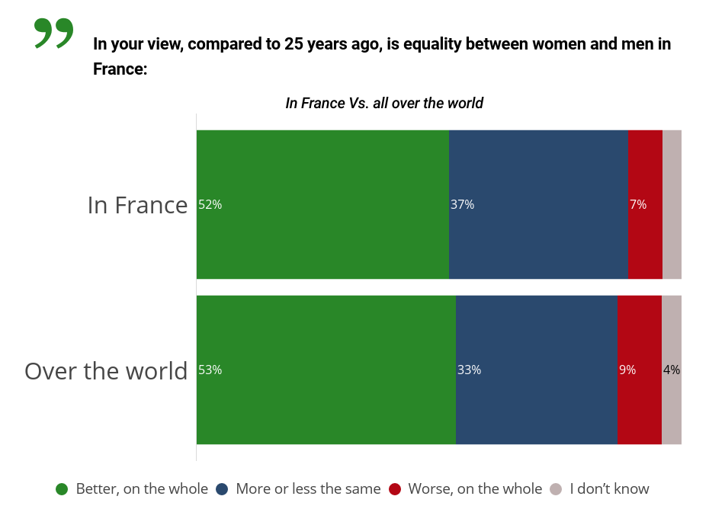



UNDER UMBARGO
-20%
-25%

Slide 9
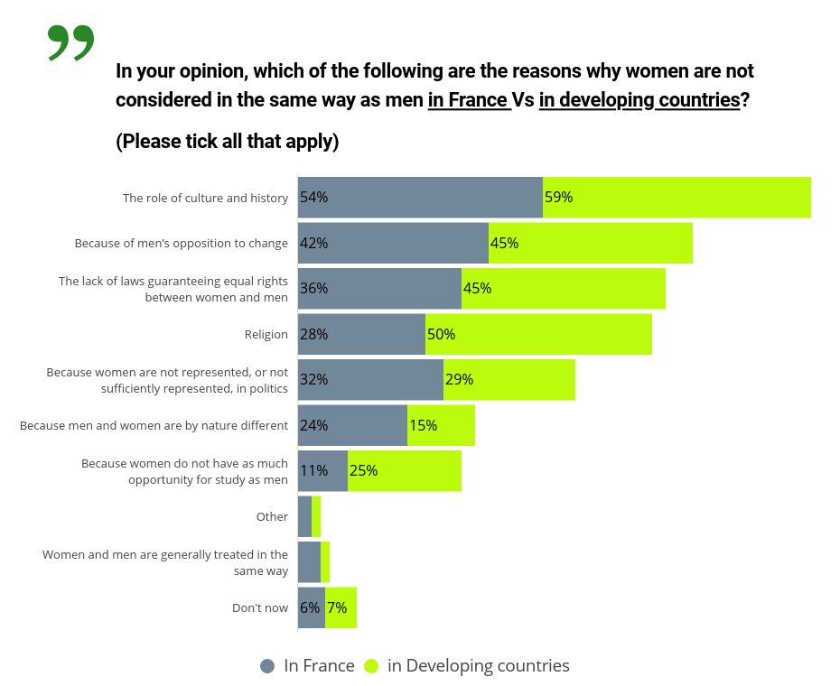

UNDER UMBARGO
in developing countries

Slide 10
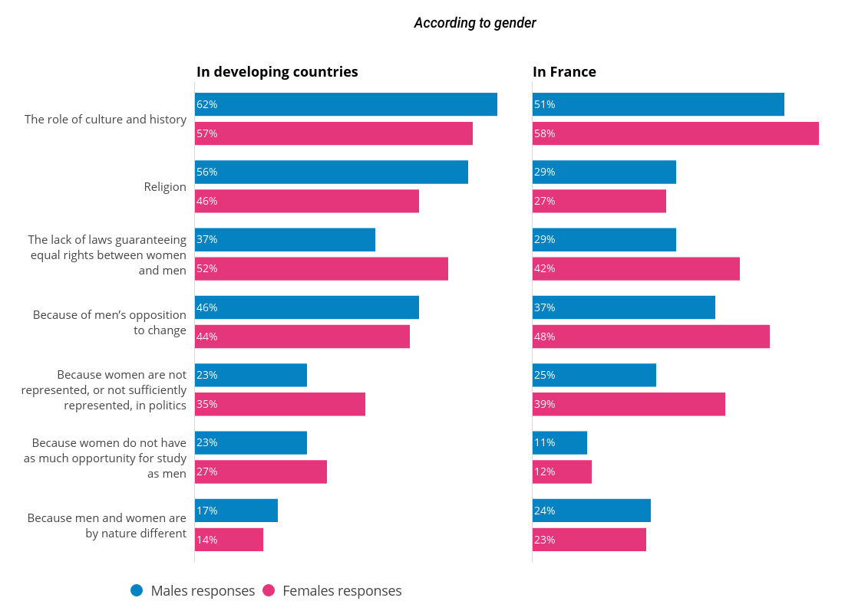
UNDER UMBARGO
Women recognize the absence of laws and the inability of men to change (especially in France)

Slide 11
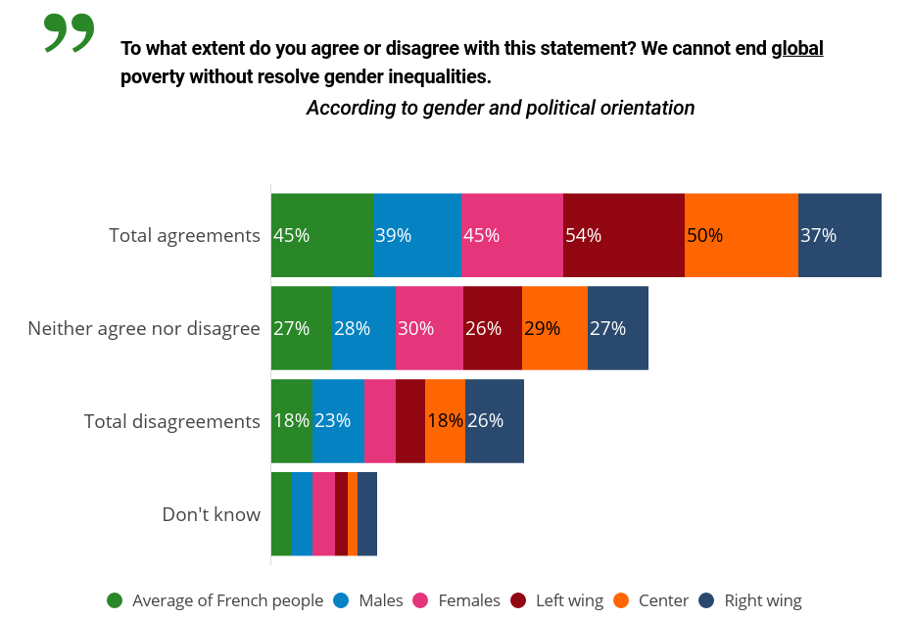
UNDER UMBARGO
6% under 25
+ 3% among people aged 65 +

Slide 12
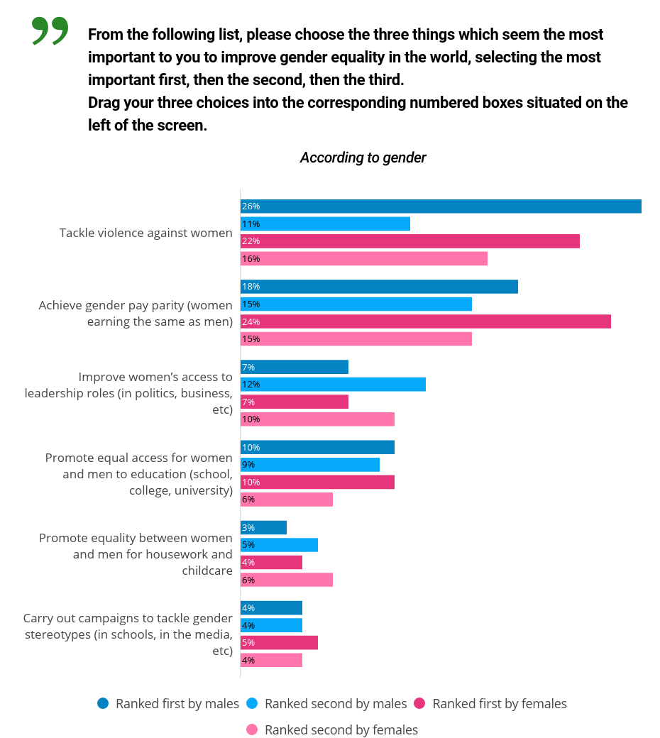
UNDER UMBARGO
Violence
Salaries
MAJOR CONCERNS
regarding gender equality

Slide 13
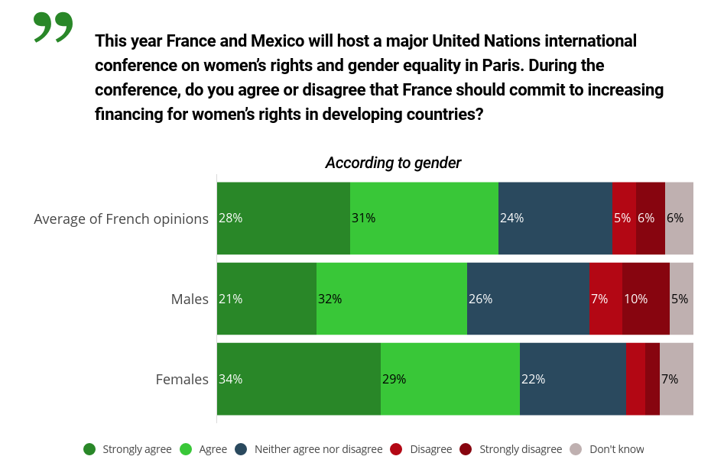
UNDER UMBARGO
- 8% at the right wing
+ 14 % at the left wing

Slide 14
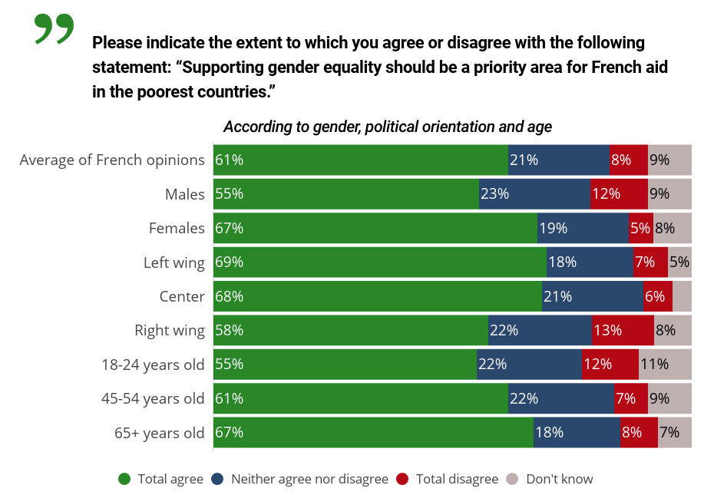
UNDER UMBARGO

Slide 15
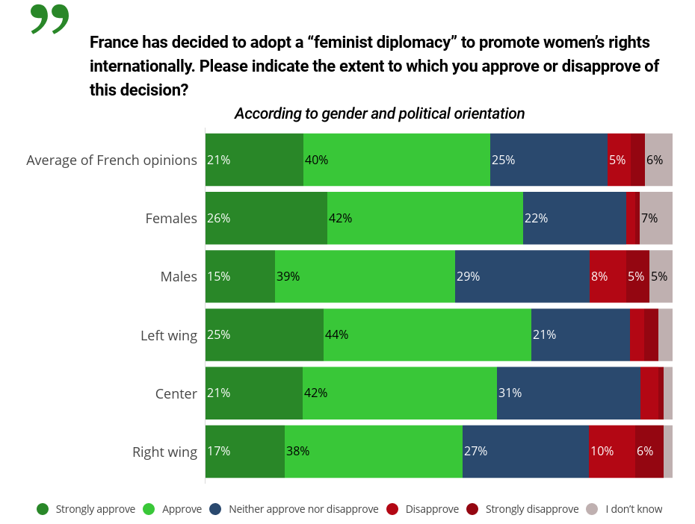
UNDER UMBARGO
Young people
The oldest
At the right wing
At the left wing

Slide 16
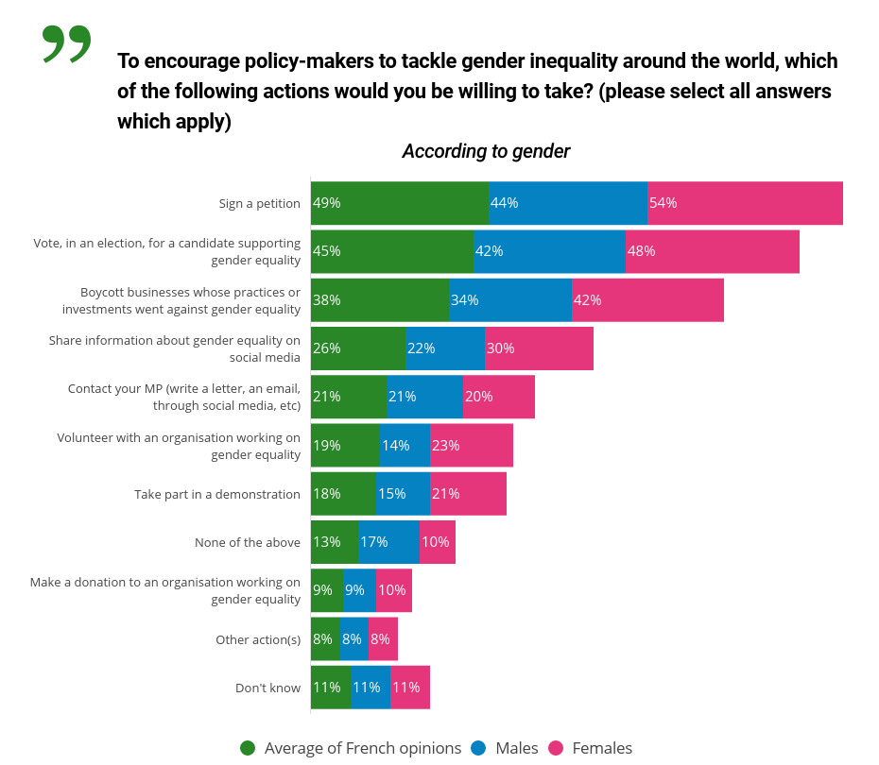
UNDER UMBARGO

Slide 17
On a domestic scale
UNDER UMBARGO

Slide 18
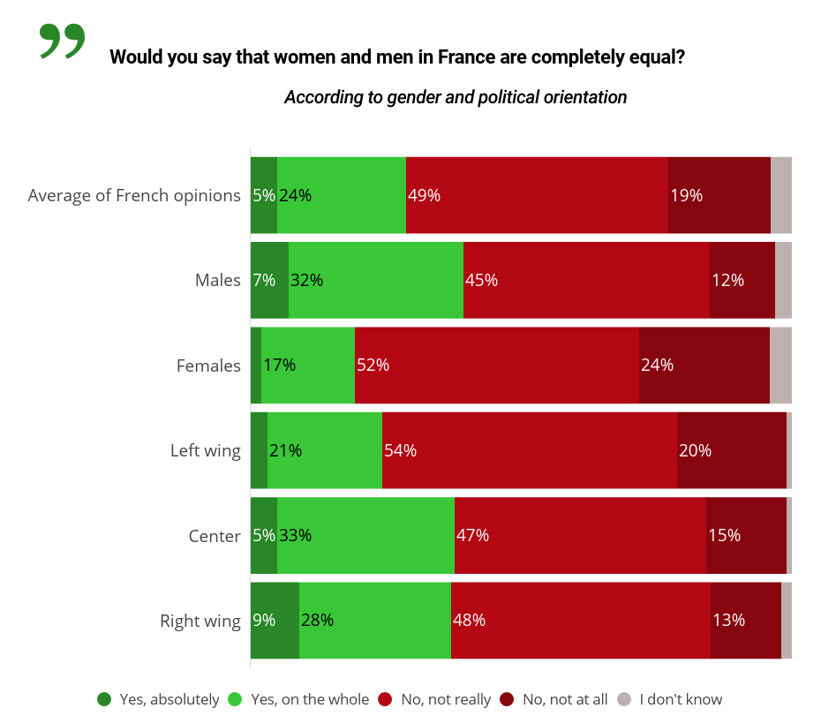
UNDER UMBARGO
Males – right wing & center

Slide 19
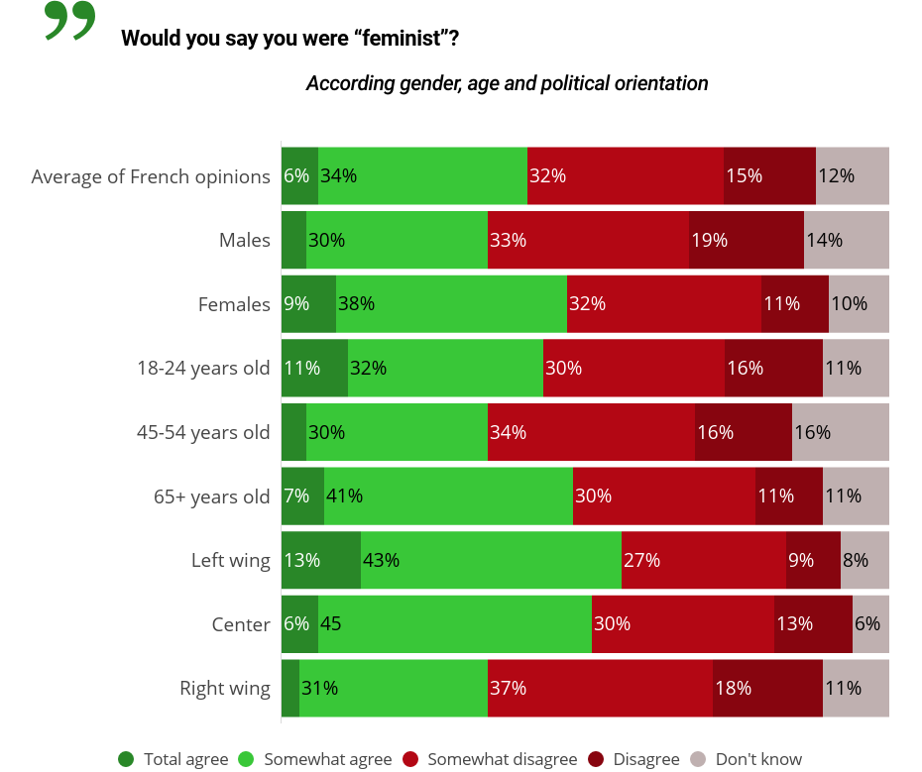

UNDER UMBARGO

Slide 20
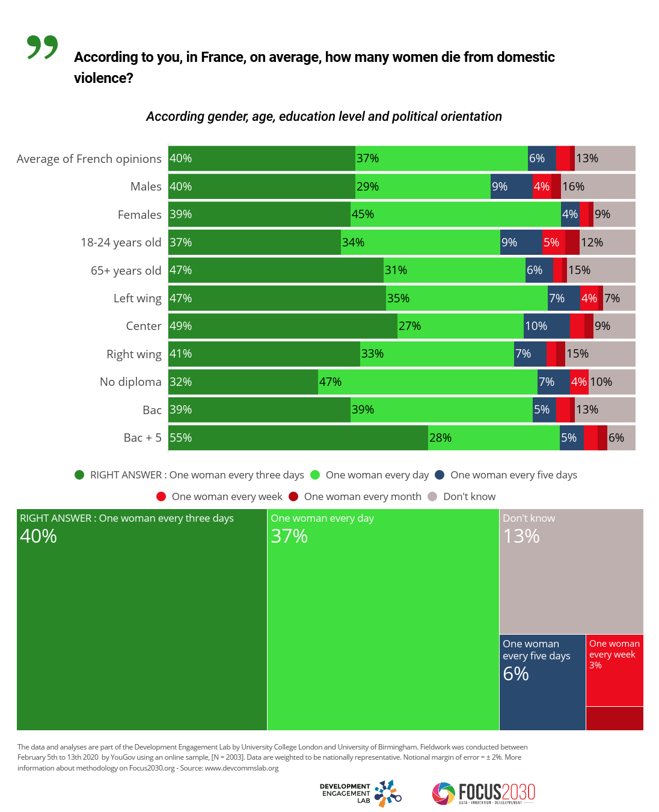
UNDER UMBARGO

Slide 21
UNDER UMBARGO
Gender
Left wing & Center
Don’t know (males)
Right wing
Educated

Slide 22
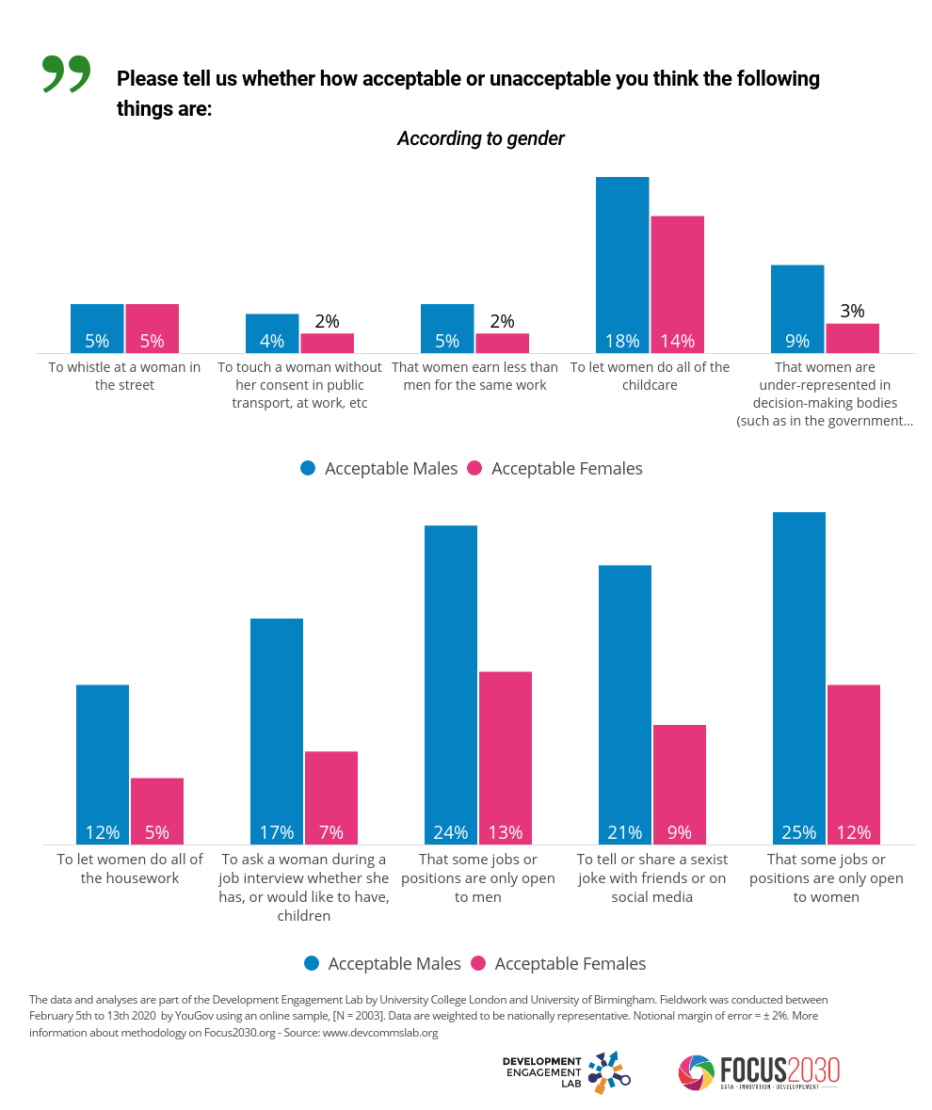
UNDER UMBARGO

Slide 23
UNDER UMBARGO

Slide 24
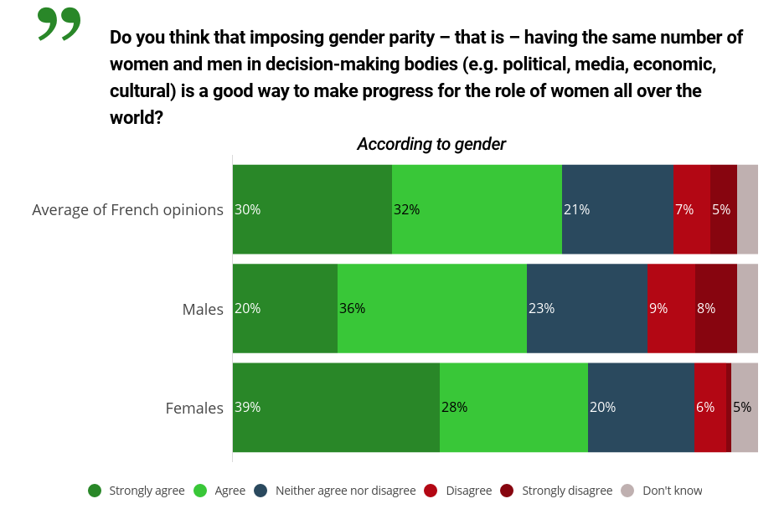
UNDER UMBARGO
Political orientation
Older
+ 15% disagreement between
non-graduates and Bac + 5

Slide 25
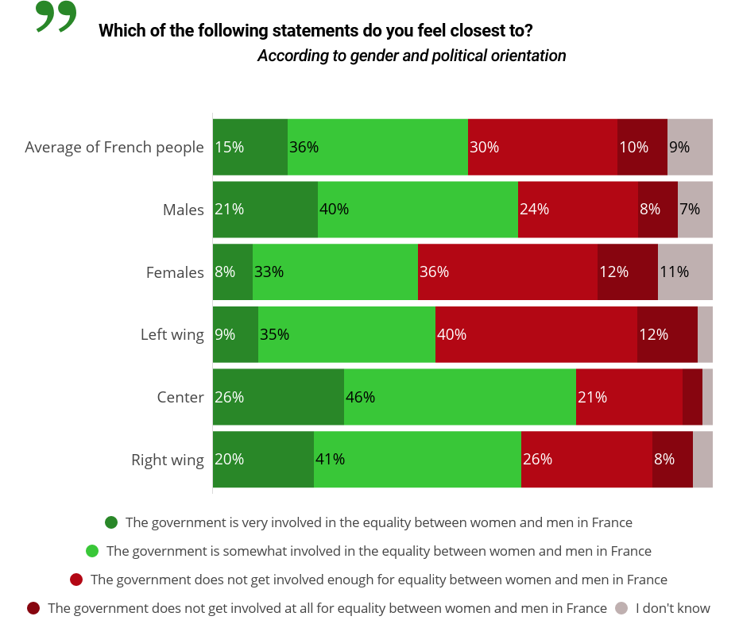
UNDER UMBARGO
Age
Center (and right wing)
Left wing

Slide 26
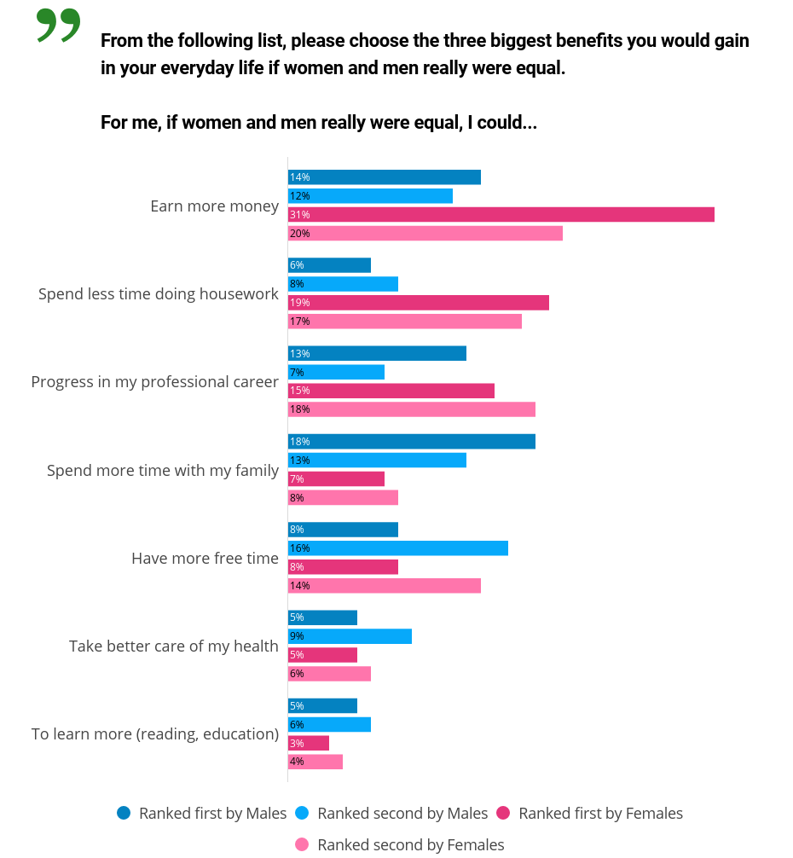
UNDER UMBARGO

Slide 27
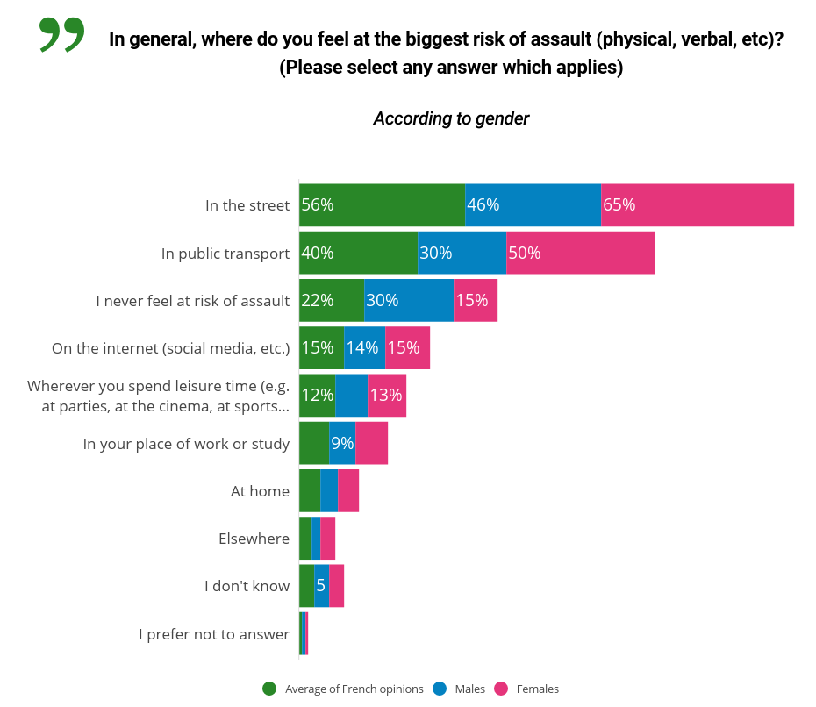
UNDER UMBARGO
Education
Political orientation
Region

Slide 28
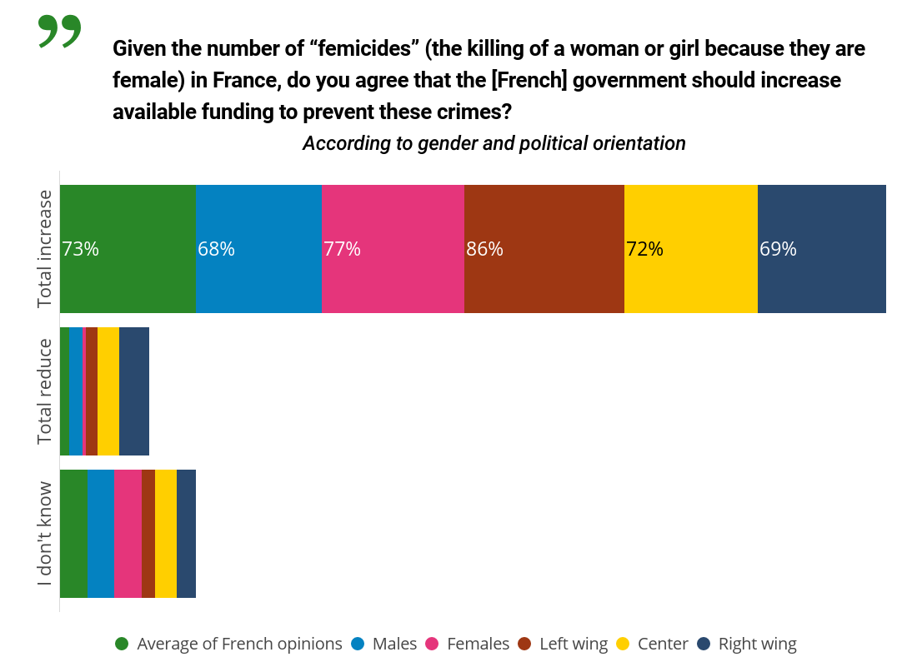
UNDER UMBARGO
-11% under 25
+ 5% in people over 55
Left wing marker

Slide 29
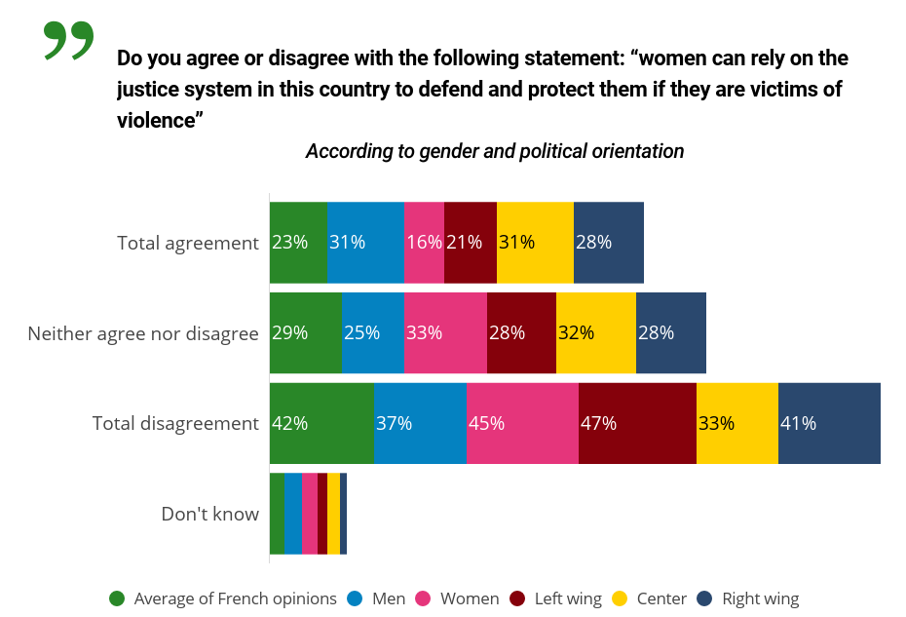
UNDER UMBARGO

Slide 30
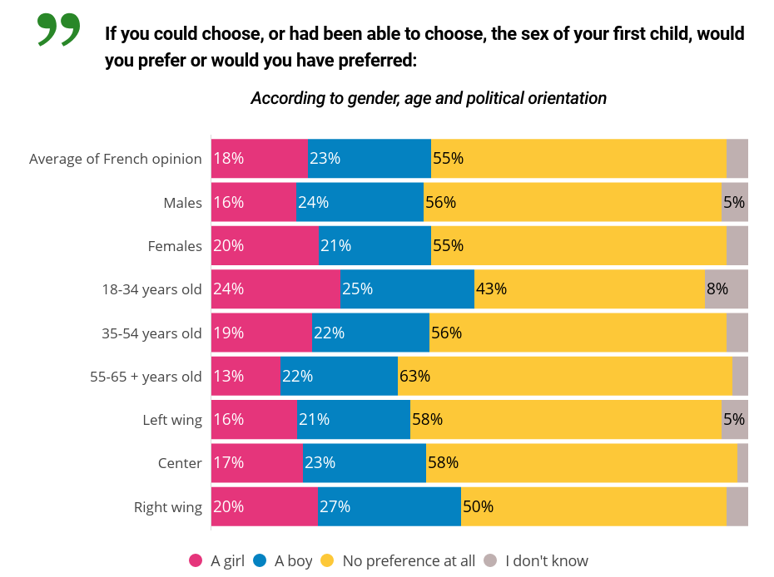
UNDER UMBARGO
At the right wing in favor of a boy
Indifference in older people
Education

Slide 31
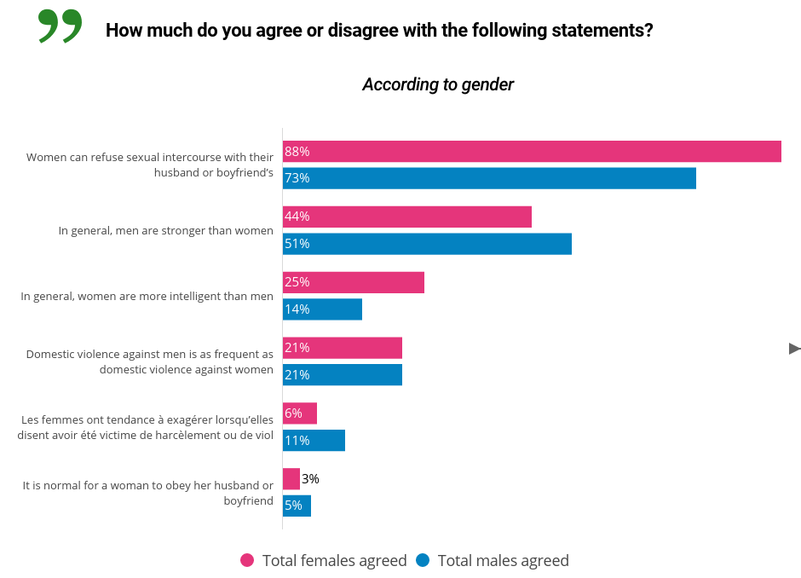

UNDER UMBARGO
-16% women (consent)
Physical / mental opposition
Age (consent)
Education (consent)
At the right wing (consent)

Slide 32
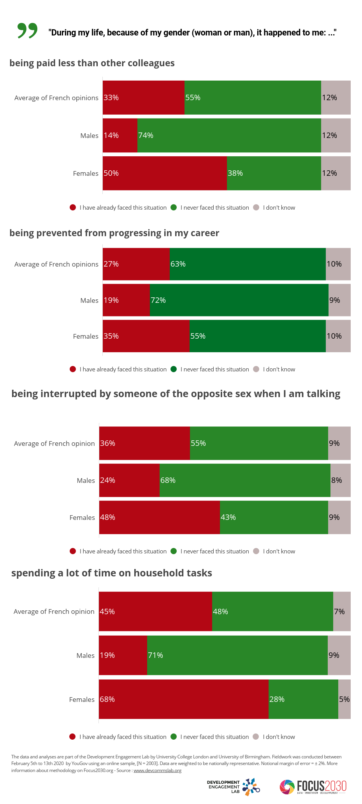

UNDER UMBARGO
Remuneration professional life
major symptoms
of gender inequality
-17% under 25
Right wing & graduates
-11% under 25
Right wing
2nd round between Macron / Le Pen

Slide 33
UNDER UMBARGO
Age & education level
+ 9% to the left compared to
the right wing
-8% under 25
Identical policy
-7% in bac + 2

Slide 34
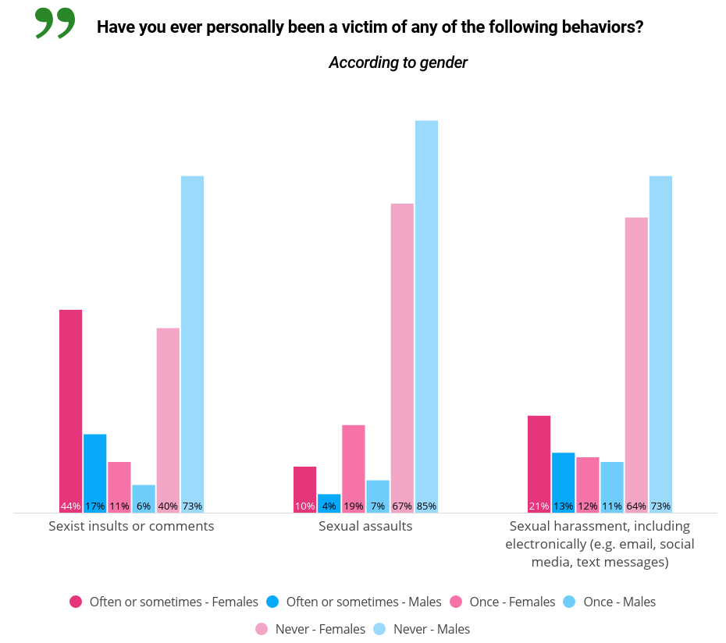
UNDER UMBARGO
Harassment declines with age
Sexist insults decrease with age
Political orientation
Sexist insults increase with education

Slide 35
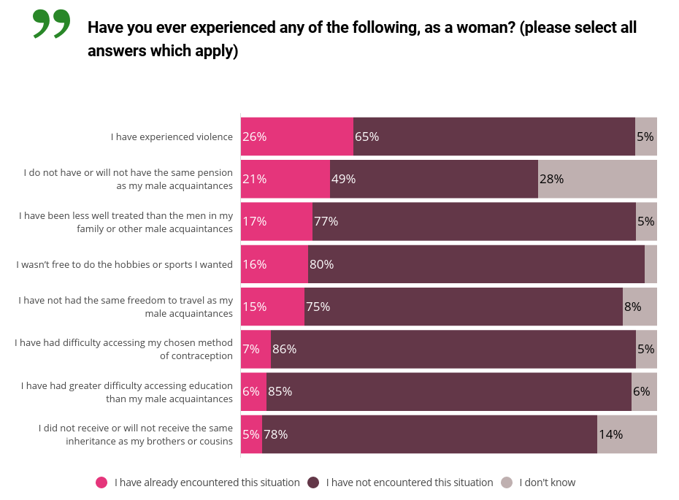
UNDER UMBARGO
Violences Rémunération
+7% Education
+10% at the left wing &
Center
- 5% at the right wing
+6% left wing
-7% right wong
+ 6% less than 35 yo

Slide 36
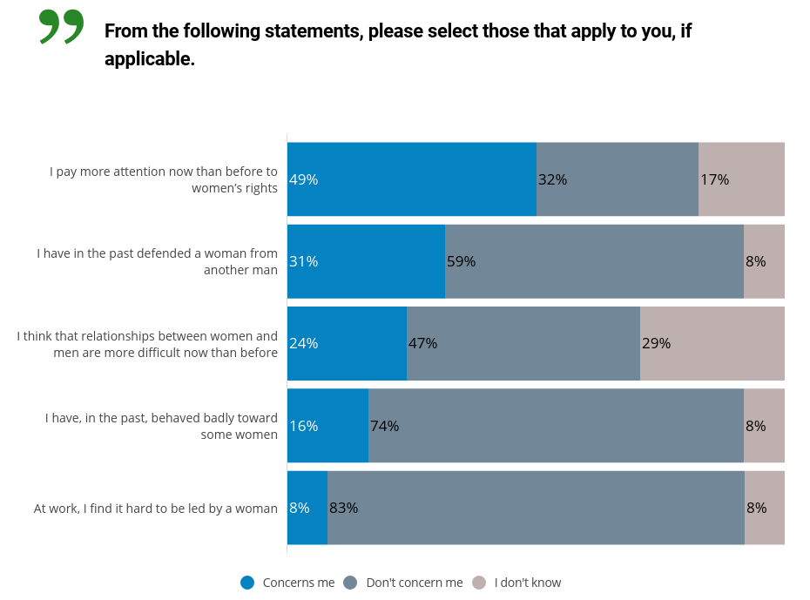
UNDER UMBARGO
+ 6% under 25 / education
+11% at the left wing
Political orientation / education
+ 6% between 25 and 34 years old

Slide 37
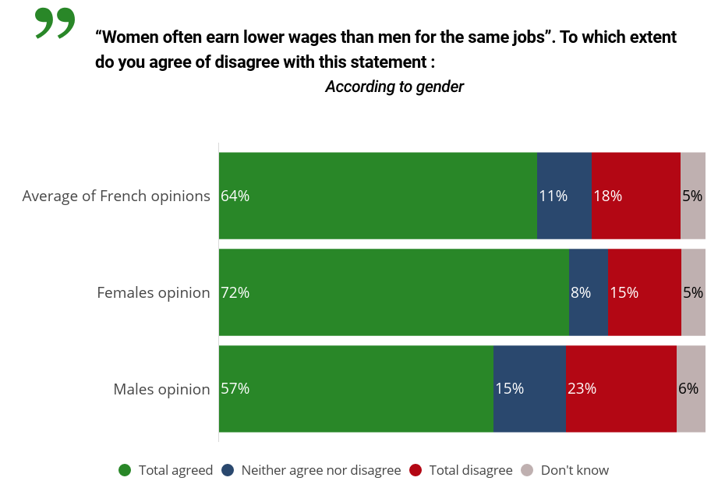
UNDER UMBARGO
+ 9% at the left wing
Macron & Le Pen voters (second presidential ballot)

Slide 38
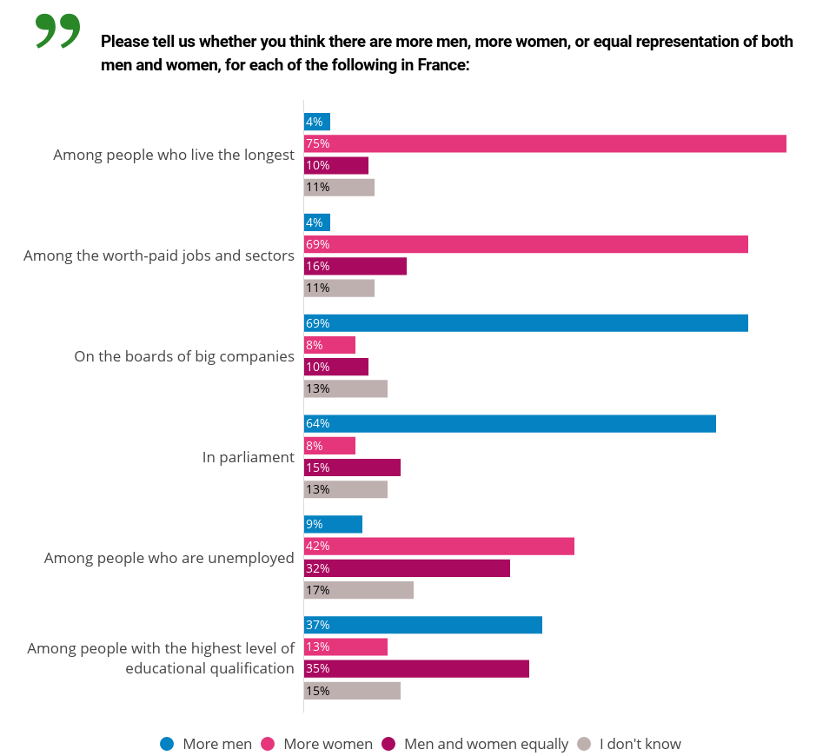
UNDER UMBARGO
Decreasing perception among young people
Growing perception among the elderly
+ 8% in the elderly
Difference 18% men and women
Respondents on the left wing more inclined
to identify differences in treatment
Don't know: young & non-graduates
Difference 16% men and women

